Slide 1

Seahorse
Research Project

Slide 2

Questions on your mind
Who is this? Why should I Iisten?
What is the problem?
What is the solution?
Is there a plan?
What are the next steps?

Slide 3
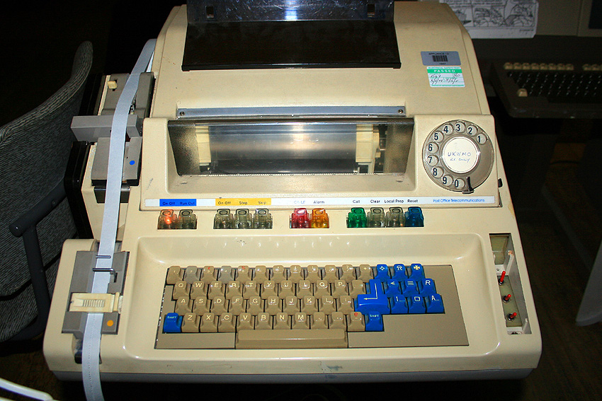
Who is this? Why should I listen?
Michael McGrath
Chief Strategist at Micro Focus
Passion for data and information
20+ years
Analytics
Machine Learning
Decision-making
FS Transformation

Slide 4
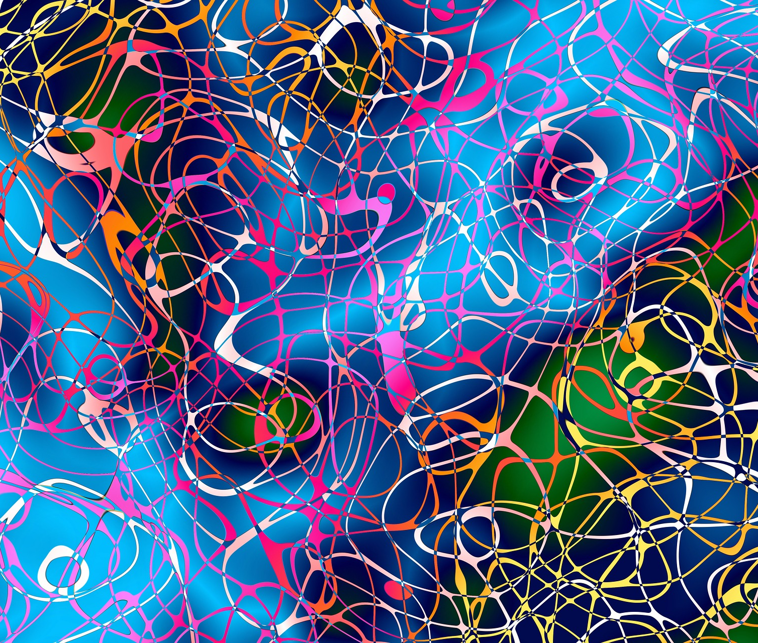
What is the problem?

Slide 5
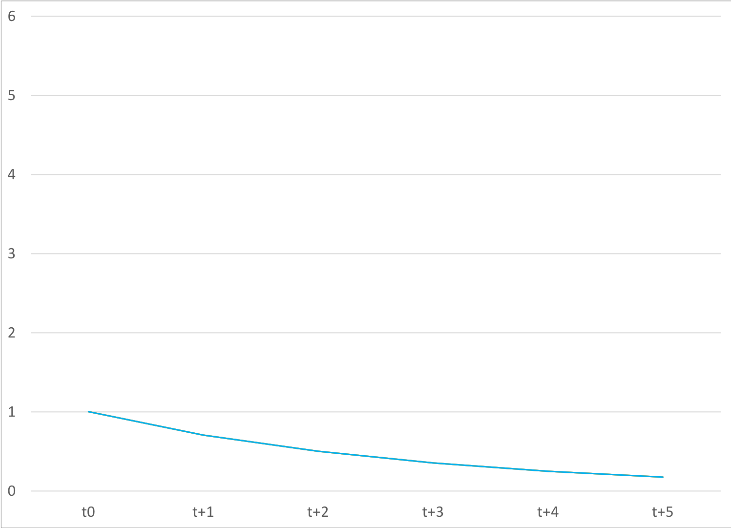
Moore’s Law

Slide 6
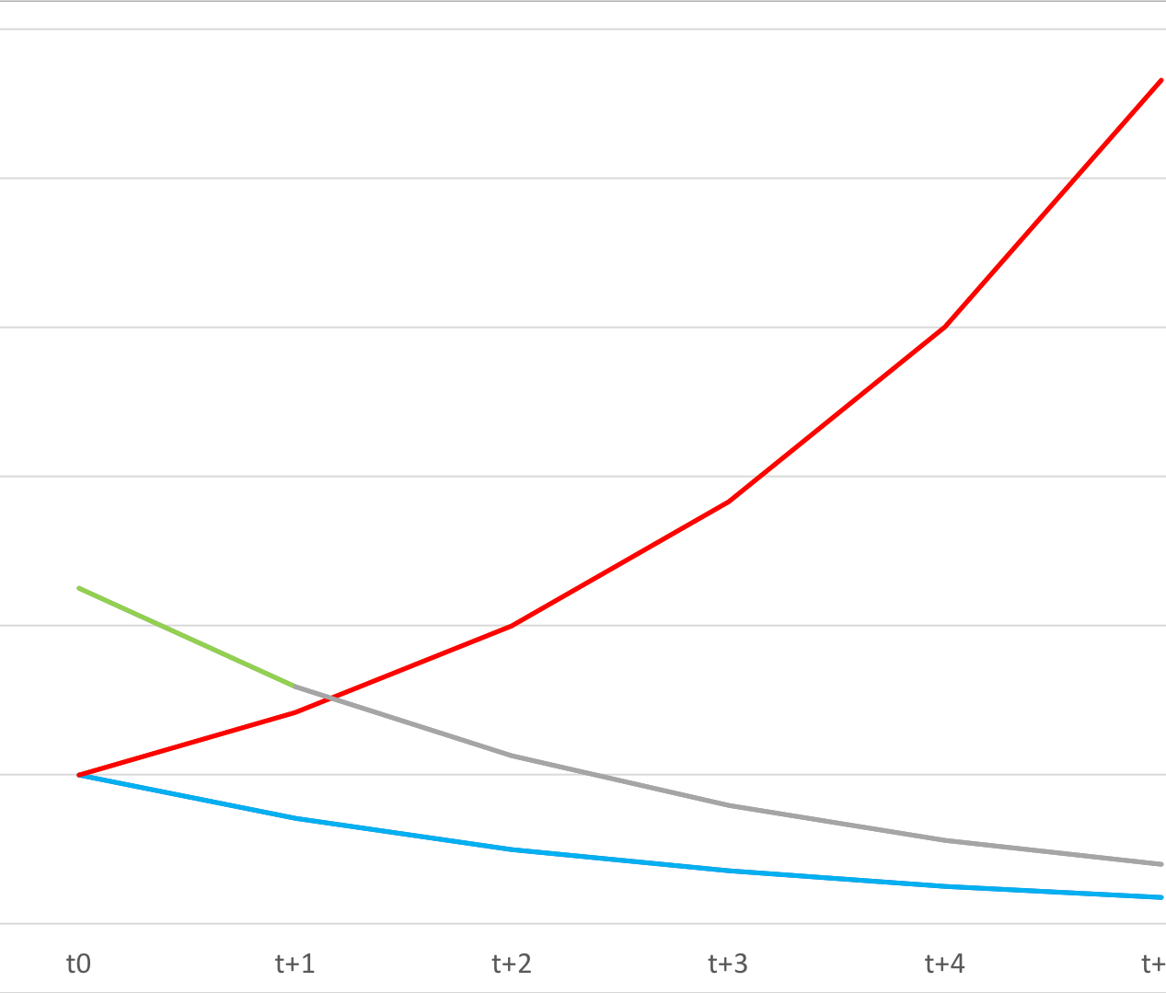
McGrath’s Paradox

Slide 7
Results in lot’s of issues
Value & Cost
Control
Privacy
Access
Corruption of Data
Duplication
Cost
Security
Error
Freedom compromised by lack of transparency and accuracy
Provenance
Source
Processing
Reliability
Robustness
Provability
Automated decision making
Data
Sharing
Fidelity
Constant transformation - Cost

Slide 8
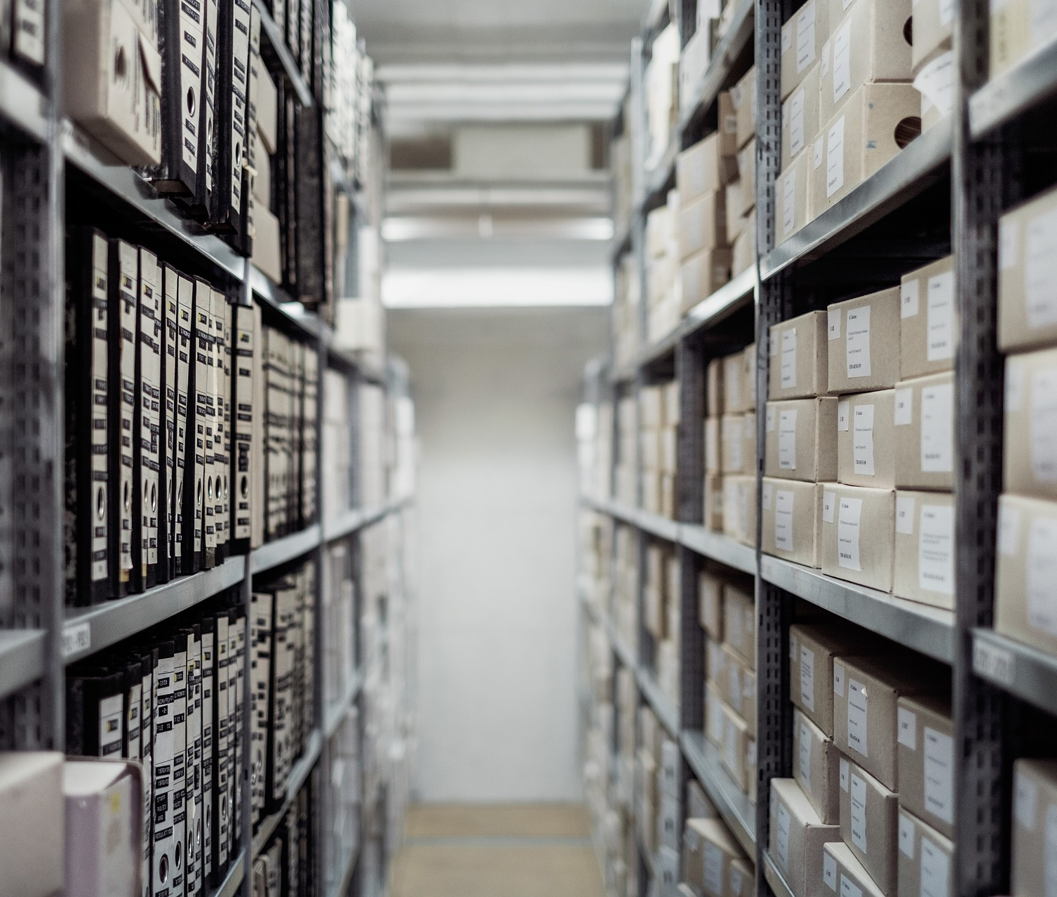
What is the solution?

Slide 9
What do we need to do
Standardize Data Lifecycle
Data Lifecycle Valuation
Data Standards & Tools
Provenance & integrity practices

Slide 10
Standardize Data Lifecycle

Slide 11
Standardize Data Lifecycle

Slide 12
Standardize Data Lifecycle

Slide 13
Research agenda

Slide 14
Standardization
Standard data object definition
Standard, open source, libraries
Transform data object to Universal Data Object (UDO)
Transform UDO to native data object
Standard rendering
UI
File
Repository

Slide 15


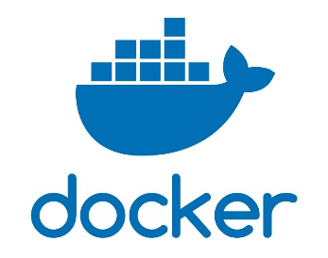
Tools
Zone of control
Data
Environment
Code

Slide 16
Benefits
Content providers (e.g. Bloomberg, Outlook, FaceBook) are incentivised to update the library in anticipation of message format changes and growing acceptance.
Applications consuming data will be able to do so even as message formats change they won’t directly compromise their systems and flows.
UDO compliant processing systems are able to process all UDO compatible message types in the same manner.
Software testing time is reduced; technology providers can deliver faster and at lower risk
Consumer testing time is reduced
Systems can process any UDO data type – They may not be coded to process every object feature.
Allows FSIs to maintain their existing investments in these types of technologies without having to constantly change to keep track of changing object types
Data migration will not require any transformation just extract and load
Assuming they incorporate the latest library in the build of their product. A smart provider could use JIT compilation or similar to mean their product does not require re-compilation.

Slide 17
Next Steps R&D
More rigorous research
Data lifecycle model
Data cost (DLCO) and value (DV), leading to
Data Value Analysis methodology
Create “Pilot” standards consortium
Define standard for 2-3 object types
Create open source libraries for these 2-3 object types
Create standards consortium

Slide 18


Next Steps Community
You:
LinkedIn linkedin.com/groups/13613770 “Seahorse Data Initiative” GitHub EmmSquared/Seahorse
“All open and open to all”

Slide 19
Questions and discussions Reach out! e: m@lainstone.com t: @dr_data l: linkedIn.com/in/michaelmcgrath

